Slide 1
SHA 1: SECURE HASHING ALGORITHM
Arti Deshpande
http://www.metamorphosite.com/one-way-hash-encryption-sha1-data-software

Slide 2
Purpose: Authentication
Not Encryption
Authentication Requirements:
  Masquerade – Insertion of message from fraudulent source
  Content Modification – Changing content of message
  Sequence Modification – Insertion, deletion and reordering sequence
  Timing Modification – Replaying valid sessions
Notes:
Verify that received messages come from the alleged source and have not been altered. Also verify the sequence and timing. Digital Signature is used to combat denial of receipt of a message by either the source or desitination.

Slide 3
Background Theory
Message Digest or “Fingerprint”
→ Condensed Representation
→ Easy to generate for a given file.
Computationally infeasible to produce two messages with same message digest
Impossible to recreate a message given a message digest.
Data Integrity and Comparison Checking
  → Message Integrity Validation

Slide 4
Applications:
One-way hash functions
Public Key Algorithms
  Password Logins
  Encryption Key Management
  Digital Signatures
Integrity Checking
  Virus and Malware Scanning
Authentication
  Secure Web Connections
    (PGP, SSL, SSH, S/MIME)

Slide 5
Variants
MD4 and MD5 by Ron Rivest (1990,1994)
SHA-0, SHA-1 by NSA (1993, 1995)
RIPEMD-160 (1996)
SHA-2 (2002 – 224, 256, 385, 512)
Whirlpool
Tiger
GOST-3411
SHA-3
  Winner selected from solicitations in 2012
Notes:
All variants have a similar framework. The variation is in the bits compressed into the digest. Thereby, differ in the number of blocks and words of data used in hashing.

Slide 6
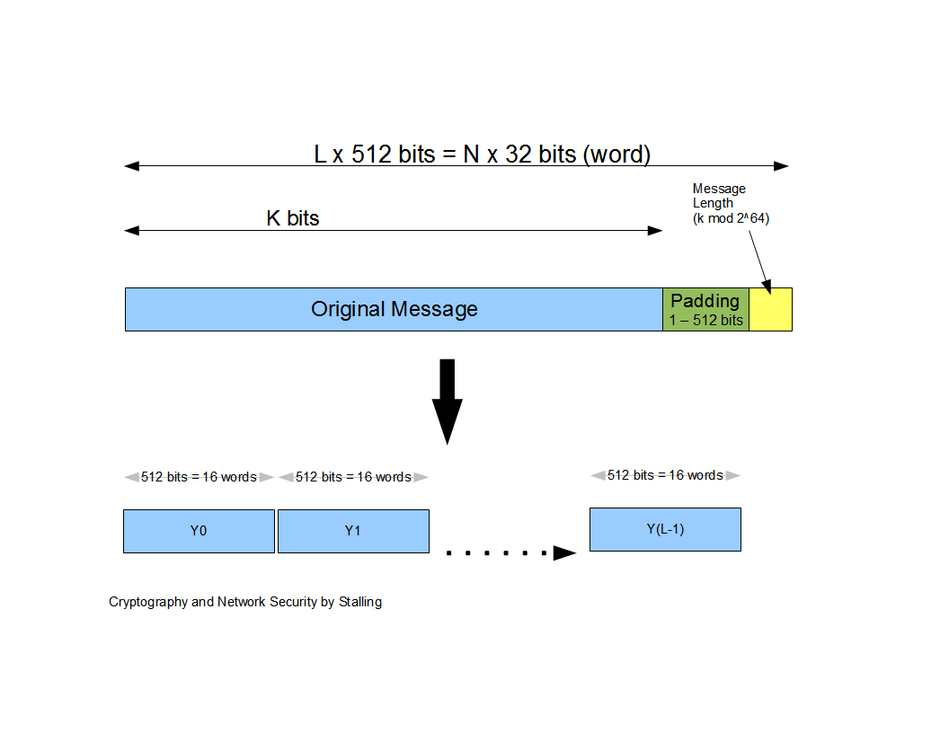
Message Diagram

Slide 7
SHA-1 (160 bit message)
Algorithm Framework
Step 1: Append Padding Bits….
Message is “padded” with a 1 and as many 0’s as necessary to bring the message length to 64 bits fewer than an even multiple of 512.
Step 2: Append Length....
64 bits are appended to the end of the padded message. These bits hold the binary format of 64 bits indicating the length of the original message.
http://www.herongyang.com
f

Slide 8
SHA-1 Framework Continued
Step 3: Prepare Processing Functions….
SHA1 requires 80 processing functions defined as:
f(t;B,C,D) = (B AND C) OR ((NOT B) AND D) ( 0 <= t <= 19)
f(t;B,C,D) = B XOR C XOR D (20 <= t <= 39)
f(t;B,C,D) = (B AND C) OR (B AND D) OR (C AND D) (40 <= t <=59)
f(t;B,C,D) = B XOR C XOR D (60 <= t <= 79)
Step 4: Prepare Processing Constants....
SHA1 requires 80 processing constant words defined as:
K(t) = 0x5A827999 ( 0 <= t <= 19)
K(t) = 0x6ED9EBA1 (20 <= t <= 39)
K(t) = 0x8F1BBCDC (40 <= t <= 59)
K(t) = 0xCA62C1D6 (60 <= t <= 79)
http://www.herongyang.com

Slide 9
SHA-1 Framework Continued
Step 5: Initialize Buffers….
SHA1 requires 160 bits or 5 buffers of words (32 bits):
H0 = 0x67452301
H1 = 0xEFCDAB89
H2 = 0x98BADCFE
H3 = 0x10325476
H4 = 0xC3D2E1F0
http://www.herongyang.com

Slide 10
SHA-1 Framework Final Step
Step 6: Processing Message in 512-bit blocks (L blocks in total message)….
This is the main task of SHA1 algorithm which loops through the padded and appended message in 512-bit blocks.
Input and predefined functions:
M[1, 2, ..., L]: Blocks of the padded and appended message f(0;B,C,D), f(1,B,C,D), ..., f(79,B,C,D): 80 Processing Functions K(0), K(1), ..., K(79): 80 Processing Constant Words
H0, H1, H2, H3, H4, H5: 5 Word buffers with initial values
http://www.herongyang.com

Slide 11
SHA-1 Framework Continued
Step 6: Pseudo Code….
For loop on k = 1 to L
(W(0),W(1),...,W(15)) = M[k] /* Divide M[k] into 16 words */
For t = 16 to 79 do:
W(t) = (W(t-3) XOR W(t-8) XOR W(t-14) XOR W(t-16)) <<< 1
A = H0, B = H1, C = H2, D = H3, E = H4
For t = 0 to 79 do:
TEMP = A<<<5 + f(t;B,C,D) + E + W(t) + K(t) E = D, D = C,
C = B<<<30, B = A, A = TEMP
End of for loop
H0 = H0 + A, H1 = H1 + B, H2 = H2 + C, H3 = H3 + D, H4 = H4 + E
End of for loop
Output:
H0, H1, H2, H3, H4, H5: Word buffers with final message digest
http://www.herongyang.com

Slide 12
Message Diagram

Slide 13
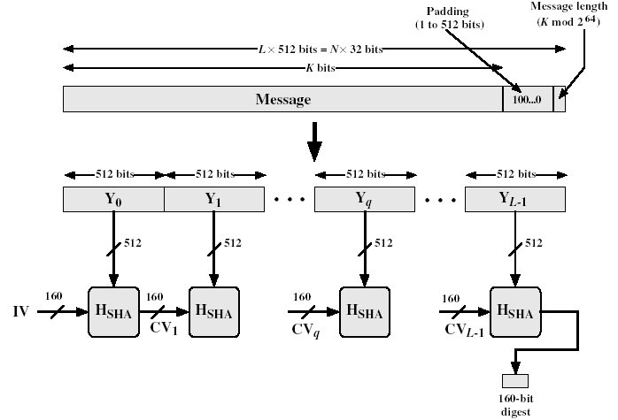
SHA-1(Secure hash algorithm)
Developed by NIST(National Institute of standards and technology).
SHA-1 Logic :
The algorithm takes as input a message with a maximum length of less than 2⁶⁴ bits and produces a 160-bit message digest.
The input is processed in 512-bit blocks.

Slide 14
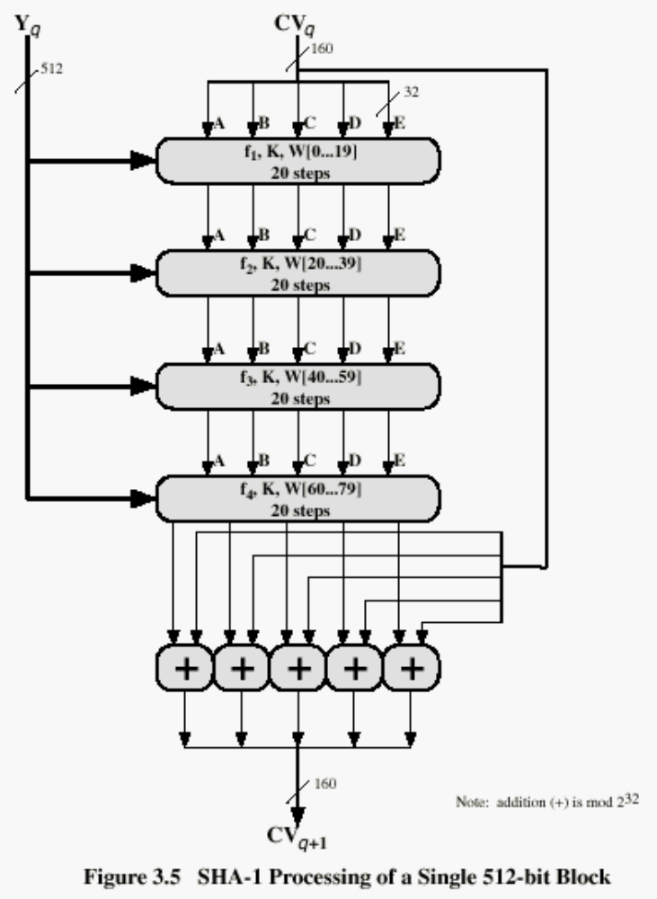
The value for these in hex are:
  For 0 ≤ t ≤ 19
    K_{t} = 5A827999
  For 20 ≤ t ≤ 39
    K_{t} = 6ED9EBA1
  For 40 ≤ t ≤ 59
    K_{t} = 8F1BBCDC
  For 60 ≤ t ≤ 79
    K_{t} = CA62C1D6

Slide 15

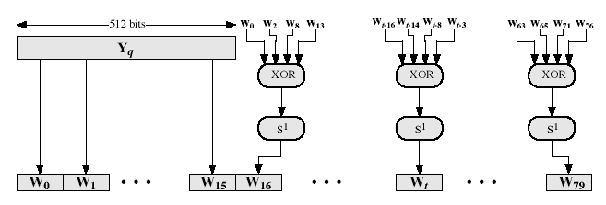
W_{t}=S¹(W_{t-16}⊕W_{t-14} ⊕W_{t-8} ⊕W_{t-3})
How the 32-bit word values Wt are derived from the 512-bit message ?
The first sixteen values of W_{t} are taken directly from the 16 words of the current block and the remaining values are defined as …
i.e. for the remaining 64 steps, the value Wt consists of the circular left shift by one bit of the XOR of 4 of the preceding values of Wt.

Slide 16
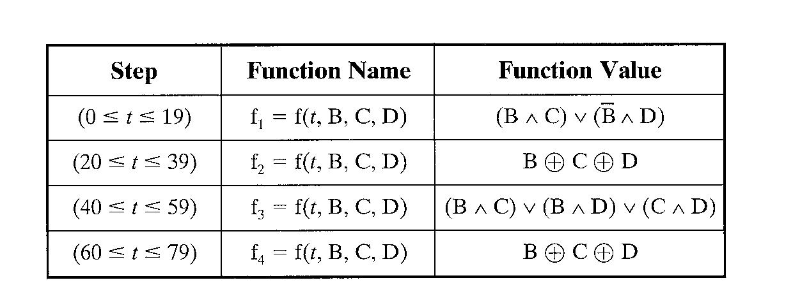
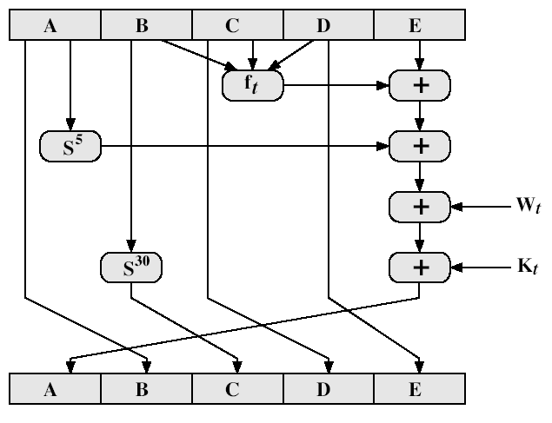
A single step of the SHA-1 operation :
S^{k} – Circular left shift of the 32-bit argument by k- bits.

Slide 17

Brute force attack for SHA-1 is harder (160 vs 128 bits for MD5)
SHA-1 is not vulnerable to any known attacks (compared to MD4/5)
(Speed) SHA-1 is a little slower than MD5 (80 vs 64 steps)
Both designed is simple and compact
SHA-1 uses big endian scheme (MD5 uses little endian scheme)

Slide 18
SHA-1 Message Digest
The message digest of the string:
“This is a test for theory of computation”
4480afca4407400b035d9debeb88bfc402db514f

Slide 19
Cryptanalysis and Limitation
Key Premises for Hash Functions:
1. Impossible to re-create a message given a fingerprint
2. Collision Free
SHA-1 failure using brute force attack in 2⁸⁰ operations
Collision failure found in 2005 in 2³³ operations

Slide 20
Bibliography
http://www.herongyang.com
http://www.ipa.go.jp/security
Salomon, David, Foundations of Computer Security Springer-Verlag London Limited 2006.
Schneier, Bruce, “Opinion: Cryptanalysis of MD% and SHA: Time for a new standard”, Computer World, August 2004.
Stallings, William, Cryptography and Network Security, Prentice Hall, 1999.
Tanenbaum, Andrew, Computer Networks, Prentice Hall, 2003.

